Slide 1
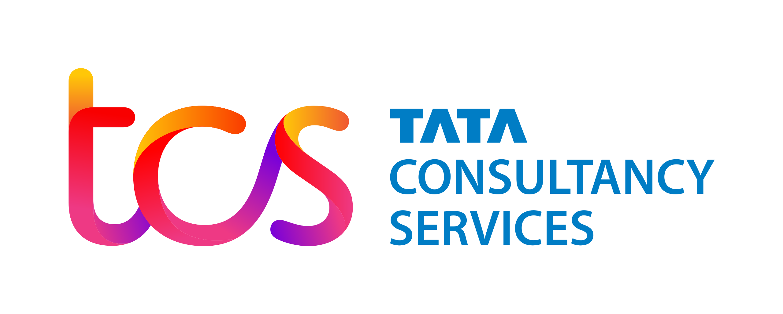




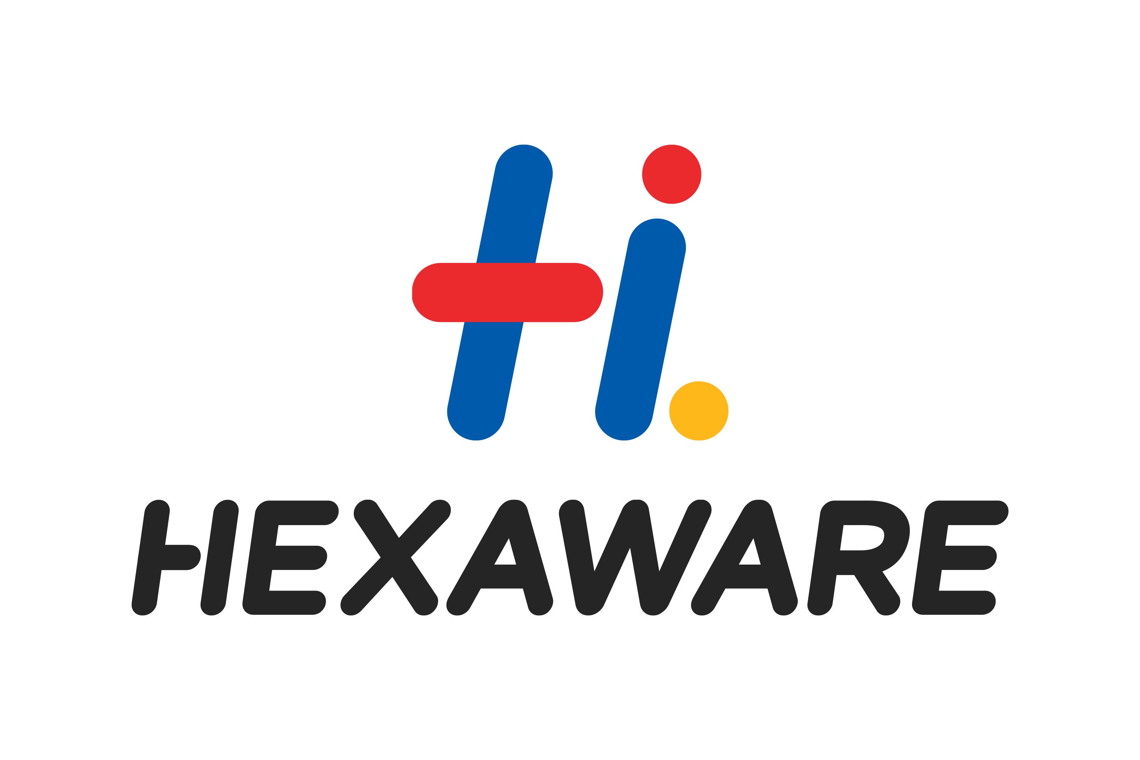




Eg: Category
Infographic Name
Skills consulting to build bench strength in next-gen digital skills (TD)
Experiential learning creates project ready skilled talent (TD)
Skills validation by integrating with LXP, LMS (TD)
Quantifiable upskilling of talent from 2G & 3G to 5G skills (TD)
iMocha
Customers*
Democratised learning & benchmarking for skill readiness (TD)
End to End Skills based Decision with Integrated Campus Hiring + FTP + TA +TD
Building a dynamic job-ready consulting workforce (TA)
Largest Campus Hiring by India’s No.1 Conglomerate – Attract, Engage, Assess, Screen, Offer (TA)
Developing talent, with product skills integrated with skill taxonomy & career pathways (TD)
Powering skills-based talent decisions across 15+ countries (TA+TD)

